Slide 1
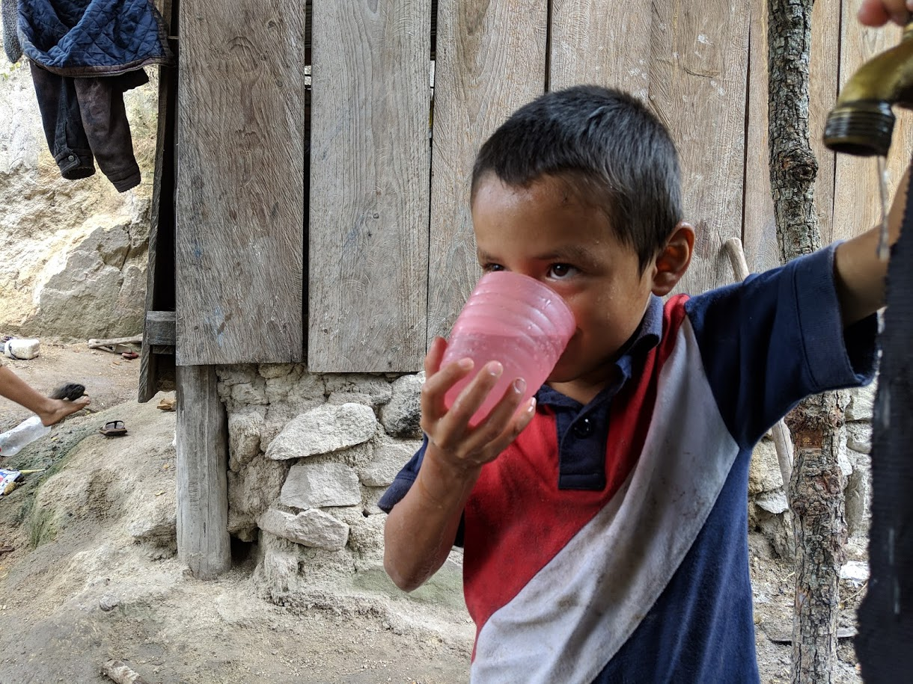
Sustainable Safe Water on Tap CEE 4520
Introduction
School of Civil and Environmental Engineering
Monroe L. Weber-Shirk
Notes:
Photo credit to Yitzy Rosenburg, 2019

Slide 2

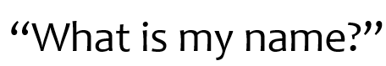
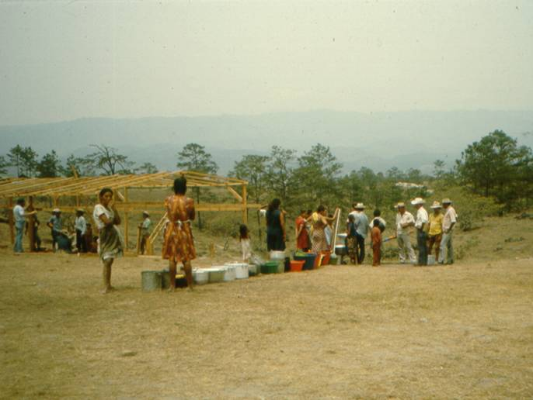
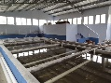

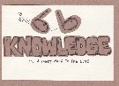
Overview
Creativity
What is this course about?
Course Organization
Introductions
Why am I teaching this course?
A search for truth that matters
Groupthink: avoiding the truth
Myth in engineering
The Challenge
It is a short walk to the edge of knowledge
Respect
AND question!
Don’t believe
everything I say
Ctrl + click the pictures to go each section!

Slide 3
Overview
Creativity
What is this course about?
Course Organization
Introductions
Why am I teaching this course?
A search for truth that matters
Groupthink: avoiding the truth
Myth in engineering
The Challenge
It is a short walk to the edge of knowledge
Respect
AND question!
Don’t believe
everything I say
Ctrl + click the pictures to go each section!

Slide 4
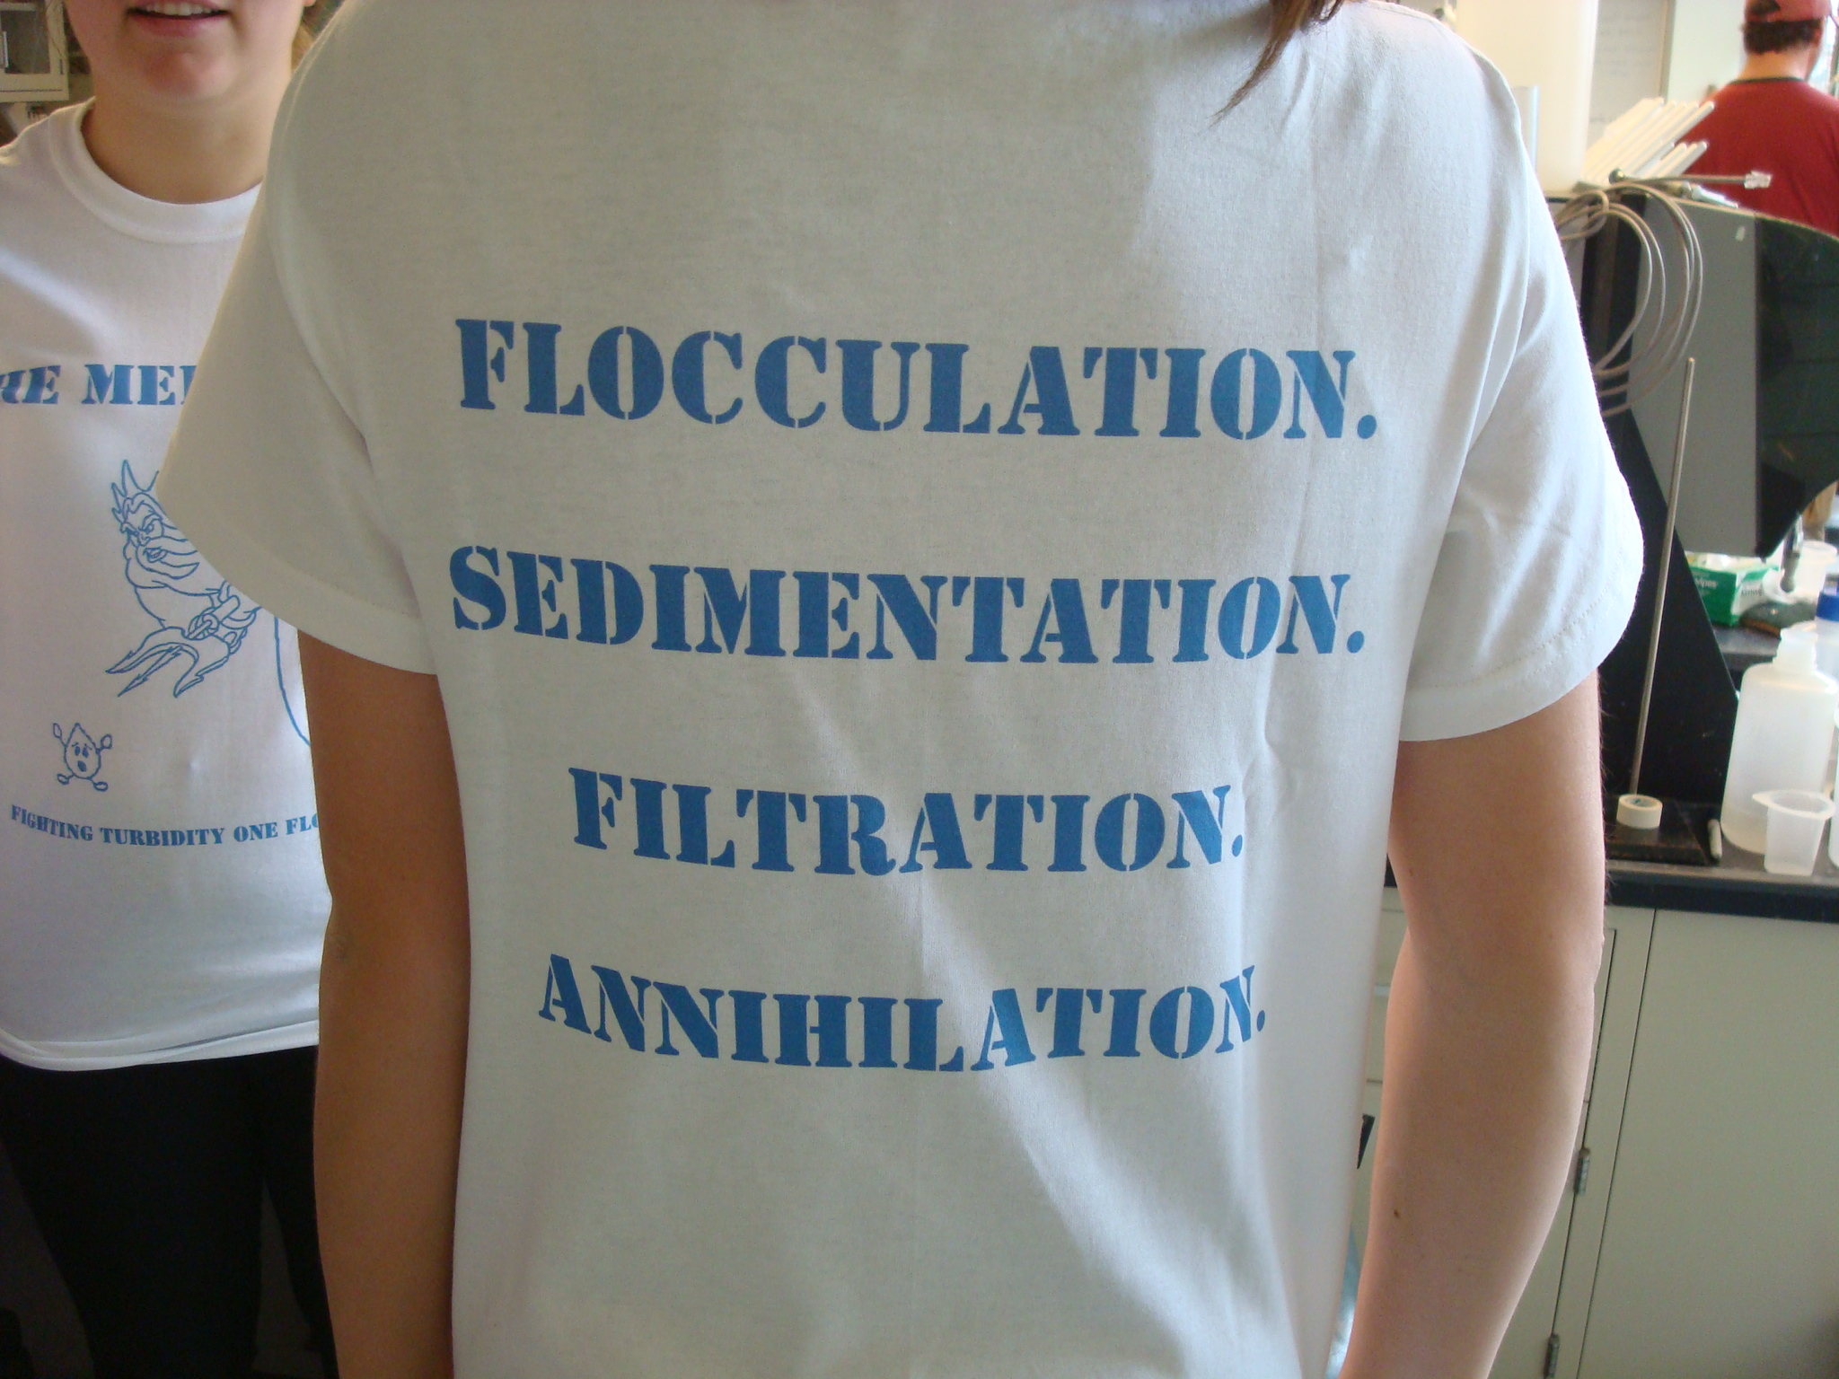
What is this course about?
Creative thinking about solutions to the enormous challenge of providing safe water on tap to communities everywhere
We will challenge the myth that this task can be accomplished by applying traditional technologies and we will identify opportunities for new insights
We will be introduced to the new field of sustainable drinking water treatment
My thesis is that engineers are needed to challenge existing assumptions and to create and document new sustainable solutions

Slide 5
What is this course about?
I have the goal of helping you develop a fundamental understanding of the processes that control the performance of each of the drinking water treatment steps
This fundamental understanding is for a VERY specific problem: the production of safe drinking water for communities starting from surface waters that are contaminated with sediment and microbes

Slide 6
Course prerequisites
CEE 3310 or equivalent Fluid Mechanics course
CEE 3310 can be taken at the same time if you are willing to work harder in CEE 4540 and use your fluids text as a reference
Online Fluids alternative https://github.com/AguaClara/CEE4520/wiki/Fluids-Review-Guide

Slide 7
Curriculum Model: AguaClara RIDE
Expert
Guide
Novice
Research and Invent
Design
SWOT: Design Course
Knowledge Generation
Knowledge Synthesis
Graduate Research
Engage
Project Based Courses
First year to M.Eng.
Every semester
Summer Internships at Cornell
Engineering in an international context
International Experience Course
Notes:
Knowledge generation (project) courses
Students learn from students with more expertise
Students generate new knowledge!
Knowledge flow is in multiple directions
Students can take the project courses multiple times from first year to Master of Engineering
Knowledge synthesis courses
Material includes recently generated knowledge
Amanda Crawford-Staub
Student Relations and Strategic Partnerships Associate
Study abroad, short term programs into curriculum, talk with many universities
By and large u’s are trying to integrate short term programs.
One course, one trip model is actually relatively new.
Old model was lecture on the trip.
Haven’t seen anything as extensive and well developed at other universities.
Model with multiple courses is unique.
70% of our students come from STEM.
Students are looking for something more than the short trip experience.

Slide 8
Overview
Creativity
What is this course about?
Course Organization
Introductions
Why am I teaching this course?
A search for truth that matters
Groupthink: avoiding the truth
Myth in engineering
The Challenge
It is a short walk to the edge of knowledge
Respect
AND question!
Don’t believe
everything I say
Ctrl + click the pictures to go each section!

Slide 9
Course Organization
CEE 4520 wiki on github: home to everything
https://github.com/AguaClara/CEE4520/wiki
Design Challenges (in teams – except for tutorial!)
?? Quizzes, 2 Exams (computer based using Python), 1 Final Project
Software skills for designing sustainable infrastructure
We will provide opportunities for you to become an expert in design using open source software
Notes:
Explain design challenges and due dates
Initial survey
Power point
Encouage students to work with PDF and take notes on top of my notes in class.

Slide 10
Design Challenges
How do you learn?
Why teams?
Drafts and final submission
Python tutorial
Start installing today! (see https://github.com/AguaClara/aguaclara_tutorial/wiki)
This Thursday’s class dedicated to making sure you can start on the Python tutorial (BRING YOUR LAPTOP)
Notes:
Play!
Sense of timelessness (time doesn’t matter)
Y

Slide 11

First Assignment
Learn how to use Atom and Hydrogen for engineering in the next 2 weeks
Hardest assignment of the semester
Start TODAY by downloading and installing software

Slide 12
Overview
Creativity
What is this course about?
Course Organization
Introductions
Why am I teaching this course?
A search for truth that matters
Groupthink: avoiding the truth
Myth in engineering
The Challenge
It is a short walk to the edge of knowledge
Respect
AND question!
Don’t believe
everything I say
Ctrl + click the pictures to go each section!

Slide 13
Introductions: Name that Student
Think about efficiency (multitasking)
Write your first name on the blackboard while you are waiting
Point to your name on the board
Describe VERY briefly something you did this summer that involved water using third person (Monroe built a dam this summer)
Ask the class, “What is my name?”

Slide 14
Overview
Creativity
What is this course about?
Course Organization
Introductions
Why am I teaching this course?
A search for truth that matters
Groupthink: avoiding the truth
Myth in engineering
The Challenge
It is a short walk to the edge of knowledge
Respect
AND question!
Don’t believe
everything I say
Ctrl + click the pictures to go each section!
Ctrl + click the pictures to go each section!

Slide 15
Why am I teaching this course?
Experience in refugee camps in Honduras in 1982-83
The spark of interest: What makes slow sand filters work?
The discovery that no one knew
Invitation to begin a water project in Latin America (12/2002)
The realization that what I had been taught wasn’t up to the challenge of solving the big global challenge of providing safe drinking water on tap to communities
14th time teaching this course – changes every time!
Notes:
Realization that we were assuming that knowing how to build water treatment facilities in the US prepared students for tackling the problem anywhere on the planet.
Issues of scale and resources (human, capital)

Slide 16
Mesa Grande: Waiting for water

Slide 17
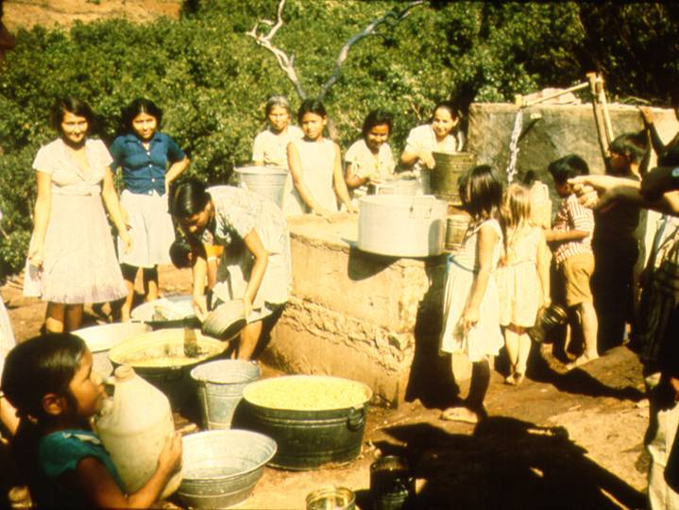
Water in Colomoncagua

Slide 18
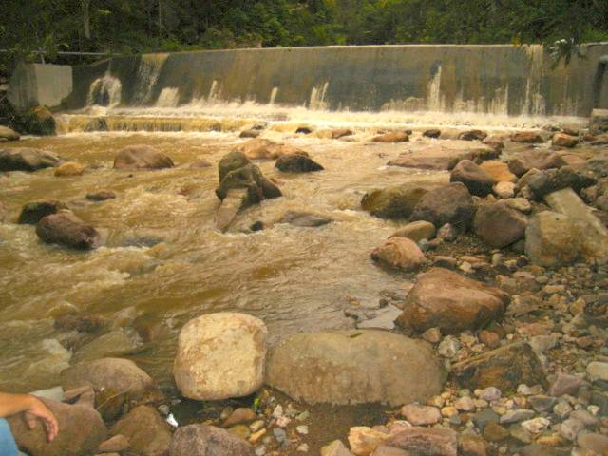

Slide 19
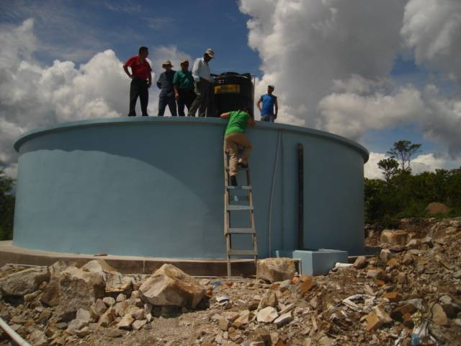

Slide 20
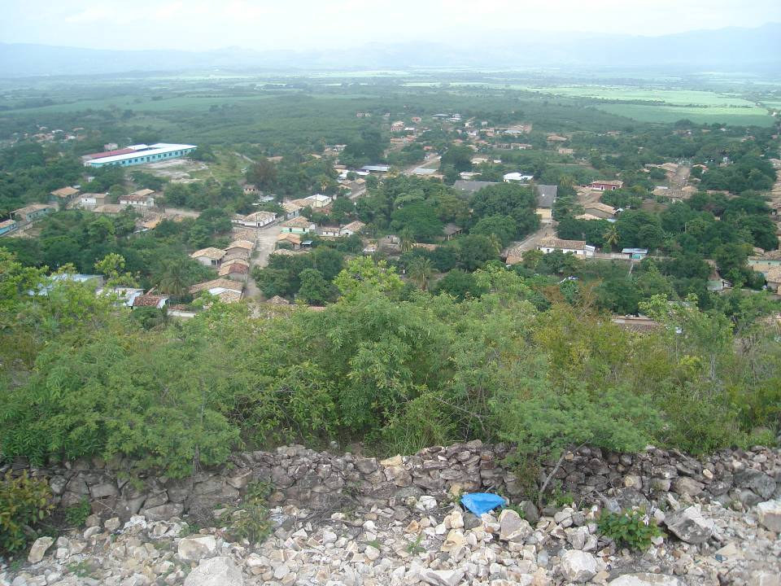

Slide 21
Overview
Creativity
What is this course about?
Course Organization
Introductions
Why am I teaching this course?
A search for truth that matters
Groupthink: avoiding the truth
Myth in engineering
The Challenge
It is a short walk to the edge of knowledge
Respect
AND question!
Don’t believe
everything I say
Ctrl + click the pictures to go each section!
Ctrl + click the pictures to go each section!

Slide 22
You should be taking a course in business or information technology
Environmental Engineering is a dead profession
The science behind environmental engineering is already well understood
Environmental engineers have been applying the same solutions for the past 100 years
Providing everyone on the planet with safe drinking water only requires the money and political will to apply known technologies
Discussion time! Do you agree?
Notes:
Dead: no! We need to be playing a major role in improving public health and in protecting the environment from human waste and
Already understood: Many things are well understood. Others need much more research (coming up)
Same solutions: Many of our solutions are 80 years old. But our 80 year old solutions haven’t provided everyone with decent water and sanitation. So we need new solutions that can be implemented where the constraints are more severe.
Known technologies: Same as previous argument. The known technologies may not be the best solution to the new types of problems we are trying to solve. And every situation requires a new assessment of which technologies are best.

Slide 23
Uneven Knowledge Space
See extra 1
nanotechnology
Water purification
WMD
pharmaceuticals
Learn from adjacent knowledge spaces!
Notes:
Much to learn
The potential for improving the well being of humans and of the planet is enormous
The challenge: to make the same progress in water supply as we are making in the hot sciences.
Nano technology is really cool. Nanotechnology isn’t going to provide the world with safe drinking water, food, or transportation networks. Some engineers should definitely explore nanotechnologies. More engineers should develop efficient and sustainable infrastructure for a healthy society.
This is science that is directly connected to the messiness of the real world. The problems can’t be solved exclusively in the lab (although there are many technical challenges that need laboratory investigations).

Slide 24
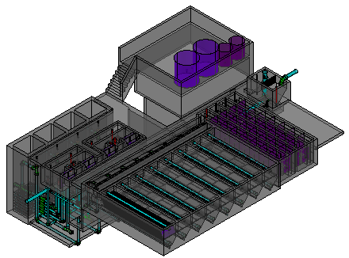
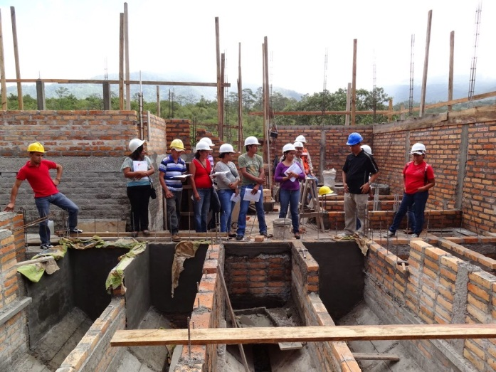
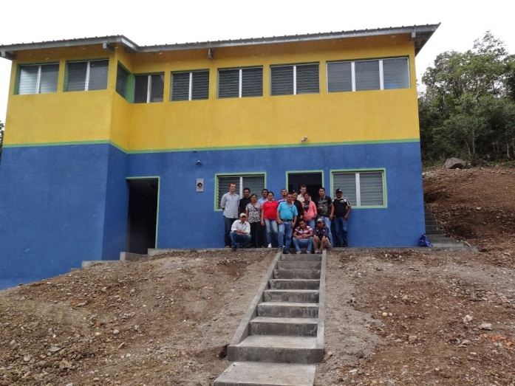

A Search for Truth that Matters
AguaClara is creating new technologies, improving old technologies, and developing the design algorithms so that others can build surface water treatment plants of any size
Math – Physics – Fluid Mechanics – Chemistry
The amazing ability to represent reality symbolically

Slide 25
Learning in a collaborative environment (Team assignments)
Our big goal is that we all learn as much as possible
How do you learn?
 | Asking for help to learn a solution | Retyping a solution | Copy/paste some solution steps | Copy/paste design challenge
Individuals within team | Excellent | Okay (but better to learn the solution strategy) | Okay (with the goal of all members understanding the steps) | Not applicable
Collaboration between teams | Excellent | No | No | No

Slide 26
Overview
Creativity
What is this course about?
Course Organization
Introductions
Why am I teaching this course?
A search for truth that matters
Groupthink: avoiding the truth
Myth in engineering
The Challenge
It is a short walk to the edge of knowledge
Respect
AND question!
Don’t believe
everything I say
Ctrl + click the pictures to go each section!
Ctrl + click the pictures to go each section!

Slide 27
Groupthink
See extra 2
Groupthink refers to faulty decision-making in a group (coined by Irving Janis, 1972)
Groups experiencing groupthink do not consider all alternatives and they desire unanimity at the expense of quality decisions
Irving, Janis. (1972). Victims of groupthink. Boston: Houghton Mifflin; Irving, Janis. (1982). Groupthink: Psychological studies of policy decisions and fiascos. 2nd ed. Boston: Houghton Mifflin.

Slide 28
Some Solutions to Groupthink
Admit that you don’t know everything!
Encourage honesty!
Question everything
Check with outside experts
Hold a "second-chance meeting" to offer one last opportunity to choose another course of action
Notes:
http://www.abacon.com/commstudies/groups/groupthink.html
Create a climate where disagreement is welcomed

Slide 29
How might Environmental Engineers fall into the trap of groupthink?
I don’t want to discover that my technology is obsolete and that the years of effort that I put into improving that technology have been a waste
Confusion of confidence and scientific proof
Reliance on empiricism rather than physics
Confusion of the ability to name a process (Flocculation) with an understanding of the physics of the process
Reduce “groupthink” by… _______________
Respect AND question!
Notes:
Dissenters are stupid
We are too often operating under the assumption that the person in the front of the room knows everything and the student role is to soak up the knowledge.
As the problems become more complex with multiple objectives the need to explore alternatives becomes very important.
How is water cleaned in an AguaClara plant?
Disagreements are encouraged!
Always look for the evidence and assess the evidence yourself. Beware of poorly substantiated conclusions.

Slide 30
Overview
Creativity
What is this course about?
Course Organization
Introductions
Why am I teaching this course?
A search for truth that matters
Groupthink: avoiding the truth
Myth in engineering
The Challenge
It is a short walk to the edge of knowledge
Respect
AND question!
Don’t believe
everything I say
Ctrl + click the pictures to go each section!
Ctrl + click the pictures to go each section!

Slide 31
Role of Myth in Environmental Engineering
See extra 3
Myth can be a useful way of understanding a complex reality
creation stories
Myth can also be used to describe generally accepted but unproven hypotheses (my usage here)
Myth #1: Science and engineering aren’t influenced by myth because they are based on the scientific method

Slide 32
Historic Examples of Myth
Malaria (bad air disease hypothesis)
Streams purify themselves in 1 mile
The air coming out of the ground under conditions of low or sinking groundwater causes typhoid
Notes:
http://www.sciencedirect.com/science?_ob=MImg&_imagekey=B6V73-45FSRSX-1-K&_cdi=5831&_orig=browse&_coverDate=09/30/2002&_sk=999639984&view=c&wchp=dGLbVtb-zSkzS&_acct=C000022719&_version=1&_userid=492137&md5=fffe3104bff87c2e91320230a4a97810&ie=f.pdf

Slide 33
Expose the Myth
Let’s expose some more environmental engineering myths
Don’t believe everything I say
You should always be asking:
How do we know that?
Why can’t we do this better?
There are many things that I have taught in this class in previous years that I now know are wrong or incomplete understandings

Slide 34
Overview
Creativity
What is this course about?
Course Organization
Introductions
Why am I teaching this course?
A search for truth that matters
Groupthink: avoiding the truth
Myth in engineering
The Challenge
It is a short walk to the edge of knowledge
Respect
AND question!
Don’t believe
everything I say
Ctrl + click the pictures to go each section!
Ctrl + click the pictures to go each section!

Slide 35
The Challenge: Sustainable Municipal Drinking Water Supplies
We need the brightest and the best to create new and better solutions so we can meet the goal of providing everyone with safe drinking water
This challenge is apparently more difficult than building a space station, designing a fuel cell, or inventing the world wide web
So let’s roll up our sleeves and begin…
Notes:
Sustainable Small-Scale Water Supplies

Slide 36
Opportunities
Honduras trip in January
Fluoride removal reactor pilot summer 2019
Honduras internship summer 2019
Fulbright Scholar!

Slide 37
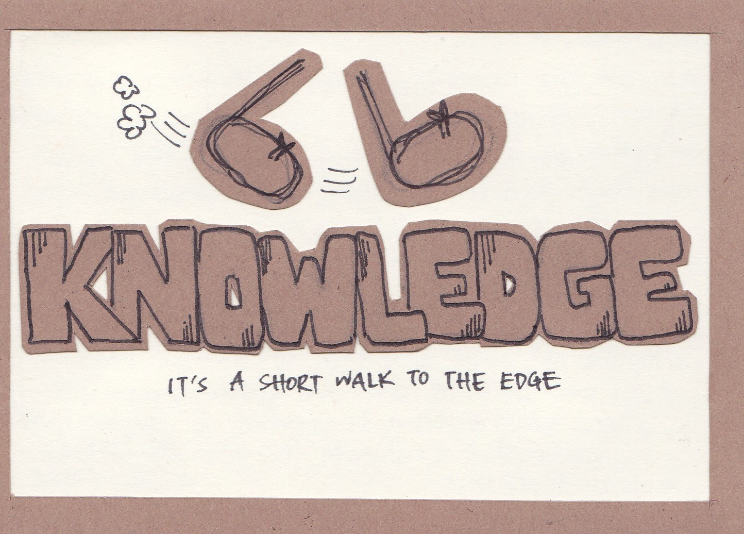

Slide 38
It is a short walk…
…to the edge of knowledge
There are significant knowledge gaps in every process that I will be teaching in this course
We aren’t able to optimize surface water treatment processes because we don’t yet understand the fundamental physics of many of the processes
We are getting closer…

Slide 39
Introduction
extras
Extra 1
Uneven Knowledge Expansions
Groupthink
Myth in Engineering
Extra 2
Extra 3

Slide 40
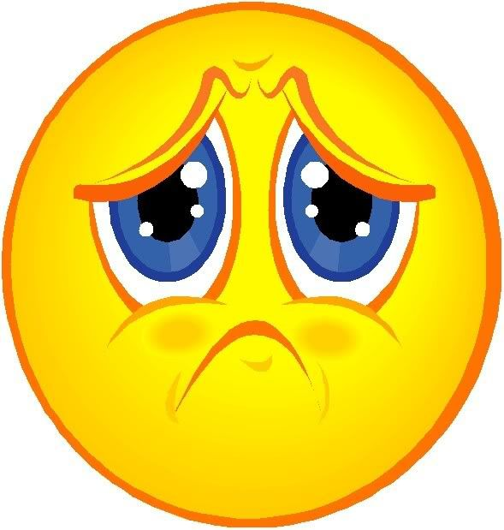
What are extras?
extras are the solution for when there’s just too much exciting information for one presentation!
While fun and exciting, this information will not be on any Design Challenges or exams

